Slide 1

BIA 672-C (Marketing Analytics)
Final Project Presentation - Fall 2023
Marketing Strategy Analysis on Trays Eatery

Slide 2
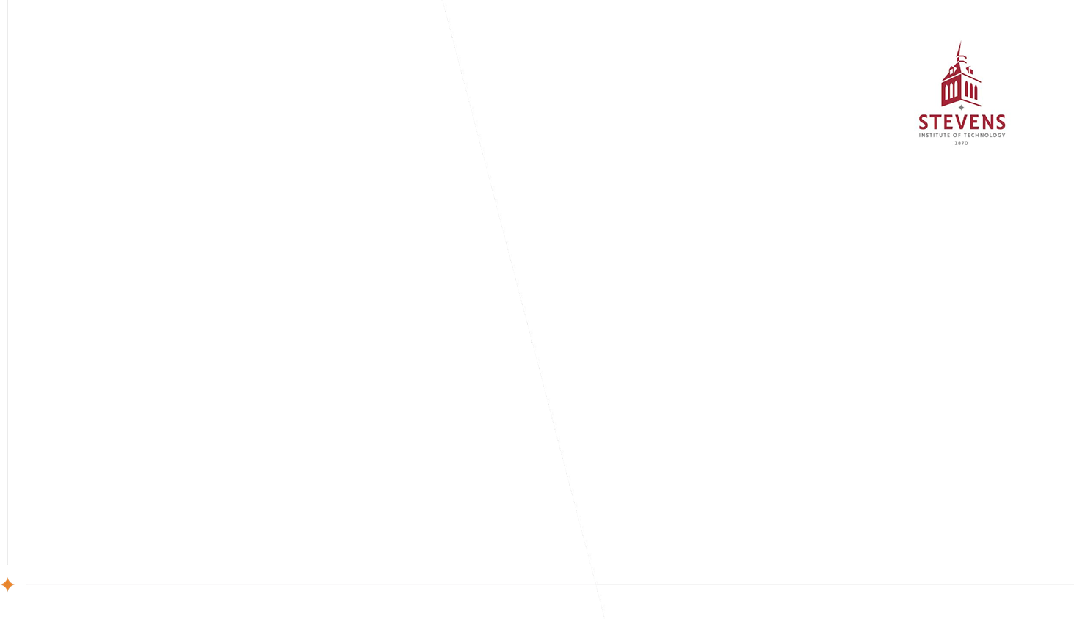
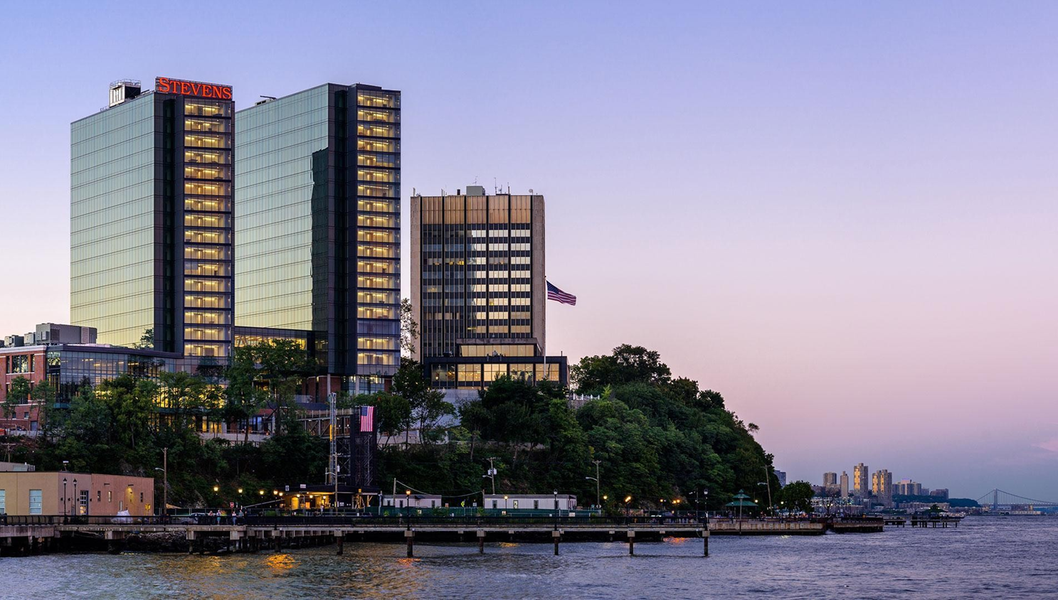
Presentation Overview
Introduction
Executive Summary
Business Description
Target Customer
Marketing and Sales Goals
Marketing Strategy and Action plan
Contingency Plan
SWOT and Competitive Analysis
Final Conclusions

Slide 3
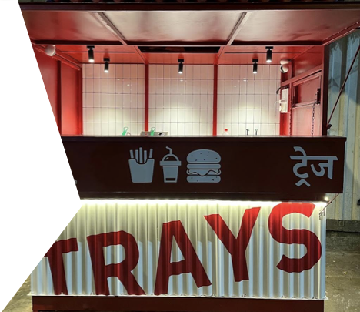
Executive Summary
Overview:
This project outlines a comprehensive marketing plan for TRAYS, a fast-food joint with its USP being its cheap on-the-go food. The plan focuses on strengthening brand awareness, driving sales growth and solidifying TRAYS’ position as a trendy hangout eatery for youngsters.
Mission:
To be the first choice for young customers seeking a quick bite.
Products:
Fries, Burgers, Shakes and Juices
Objectives:
Increase brand awareness, drive sales growth, enhance customer engagement, strengthen brand positioning, and make the brand popular among youngsters.

Slide 4
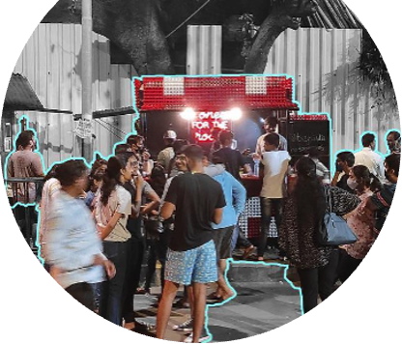
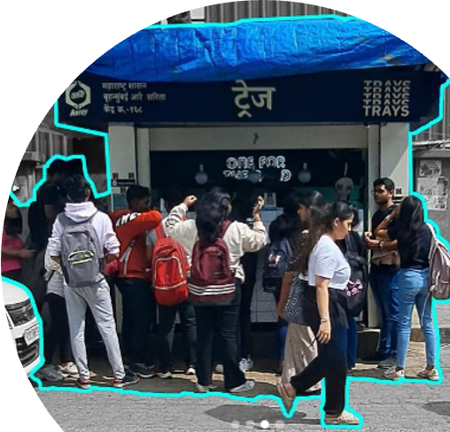
Target Market - Demographics and Psychographics
Demographics:
•Age: Primarily young people ages 15 to 25.
•Income Level: College kids on a budget.
•Gender: No specific gender bias, appealing to both men and women.
•Location: 3 locations in the city of Mumbai i.e., Jogeshwari, Vile Parle and Ghatkopar.
Psychographics:
•Lifestyle: Targets students.
•Values: Appeals to individuals on a budget.
•Interests: Satisfies fast food cravings.

Slide 5
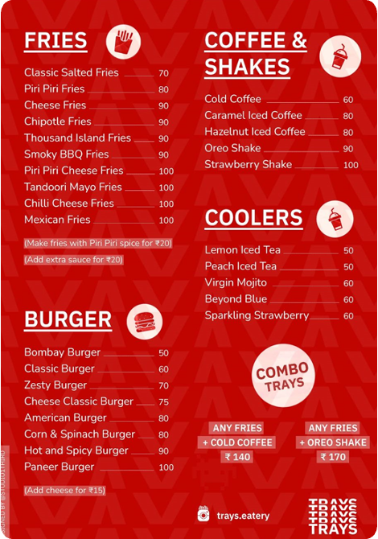
Pricing and Distribution Channels
Distribution Channels
•TRAYS operates through three physical joints strategically located in Jogeshwari, Vile Parle, and Ghatkopar.
•TRAYS extends its reach through online ordering platforms, including Swiggy and Zomato.
•Leveraging the wide reach of these platforms to tap into a larger customer base beyond the immediate vicinity of physical stores.
Pricing
•TRAYS adopts a pocket-friendly pricing strategy, ensuring accessibility for the college-going audience.
•The menu is strategically priced to cater to the budget constraints of young customers.
•Around 90% of the items are under just 100 rupees.

Slide 6
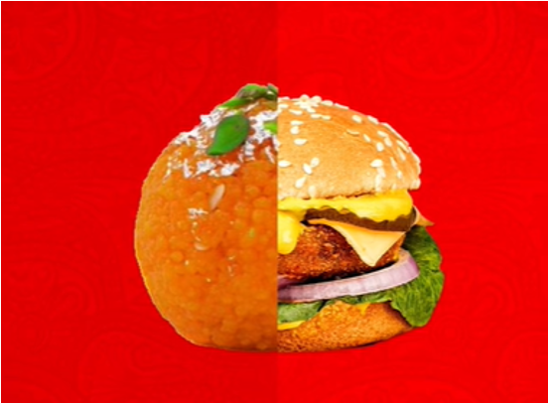

Pricing and Distribution Channels
Advertising and Promotions
•College Fests
•Experiential Marketing
•Food Blogger Partnerships
•Social Media Marketing

Slide 7
SWOT Analysis
Strengths:
Low Prices
Hygenic Quality Street Food
Proximity to Colleges
Franchises are Autonomous
Opportunities:
Untapped Market
Online Presence
Opening Multiple Franchises
Corporate Orders
S
O
Threats:
Competition from Reputed Chains
Inflation
Changing Consumer Preferences
W
Weaknesses:
Limited Experience
Limited Menu
No Sitting Area
T

Slide 8
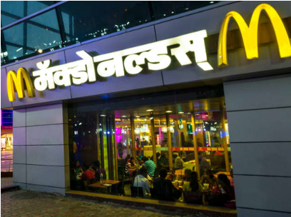
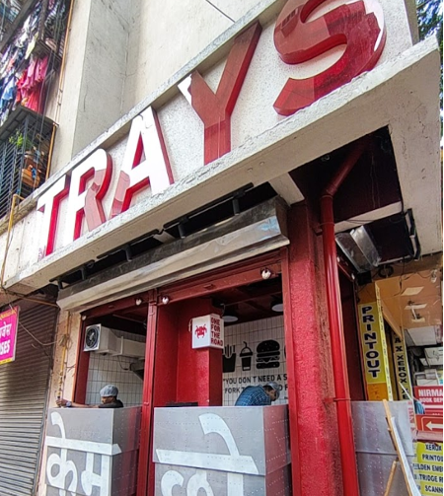
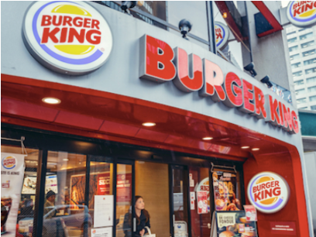
Competitive Analysis
Advantages Over Competition
•Cheaper Rates: Burgers start at just Rs 50 and Fries at Rs 70. Whereas the competition has nothing under the Rs 100 price point.
•Personal Touch: A sense of personal touch is always felt when purchasing from a small business.
•Quality Ingredients: Exclusive use of high-quality ingredients provides a superior taste that stands out in the market.
Threats from Competitors
•Diverse Offerings: Competitors with a broader range of menu options may attract customers looking for variety.
•Better Experience: Rival businesses offering better overall experience as they are established chains.

Slide 9
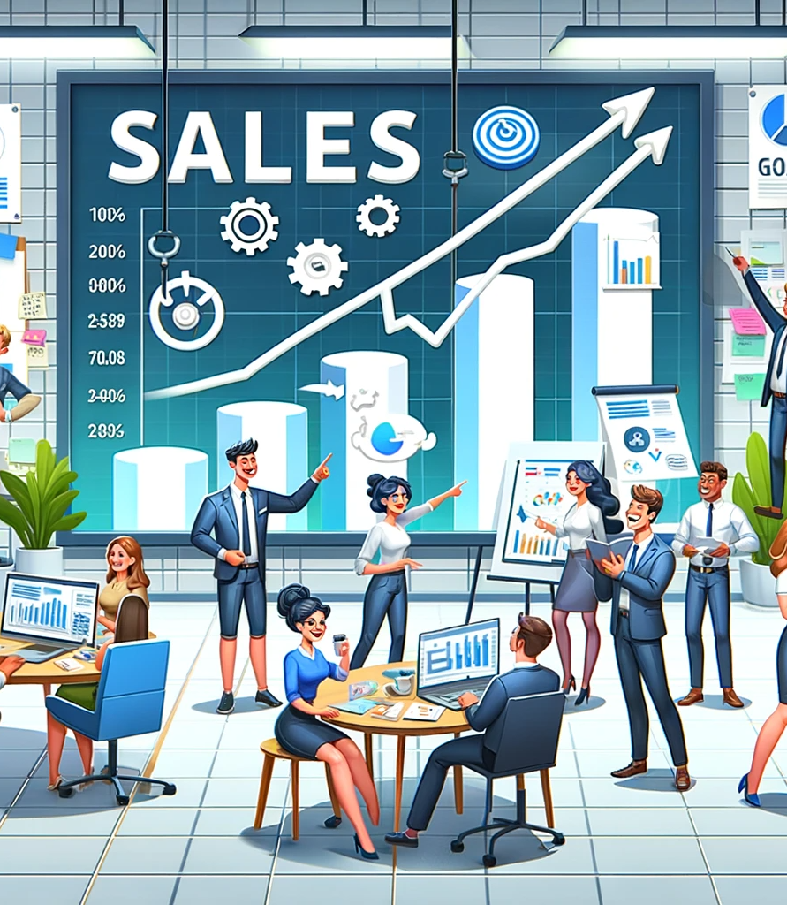
Marketing and Sales Goals
Brand Awareness and Engagement Goals
•Increase brand awareness by 20% by the end of the year 2024.
•Gain eyeballs on social media pages. More views and more interactions by 25%
•Partner with corporates and more colleges to up the revenue and feedback.
Sales and Revenue Goals
•Achieve a 50% increase in overall revenue.
•Open at 2-3 new locations next year.
•Increase online orders by 30% through targeted campaigns.
•Grow average order value by 15% by introducing new product offerings and bundle packages.

Slide 10
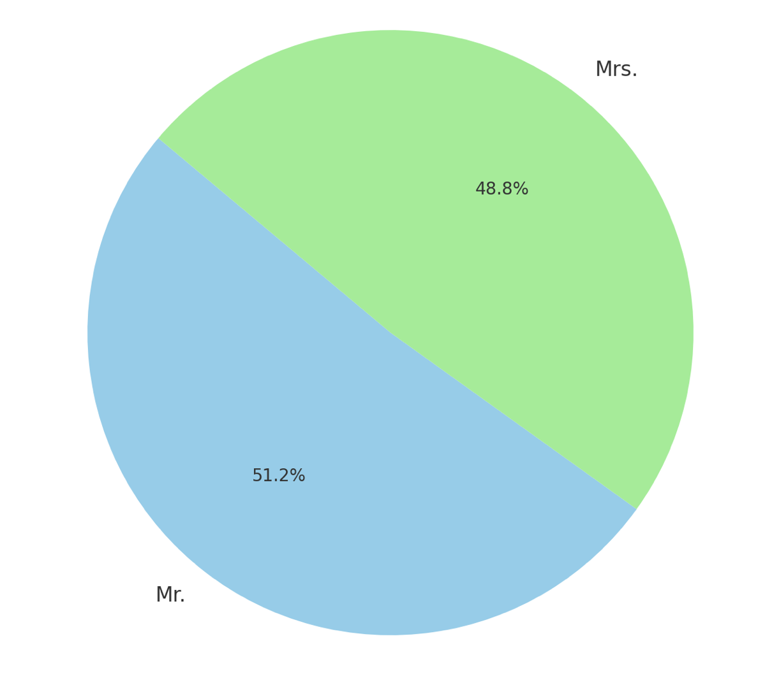
Customer Segmentation

Slide 11
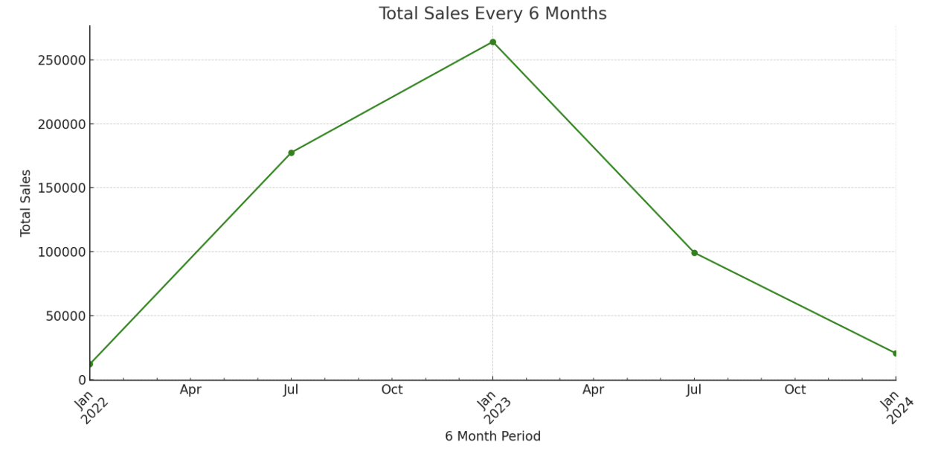

Slide 12
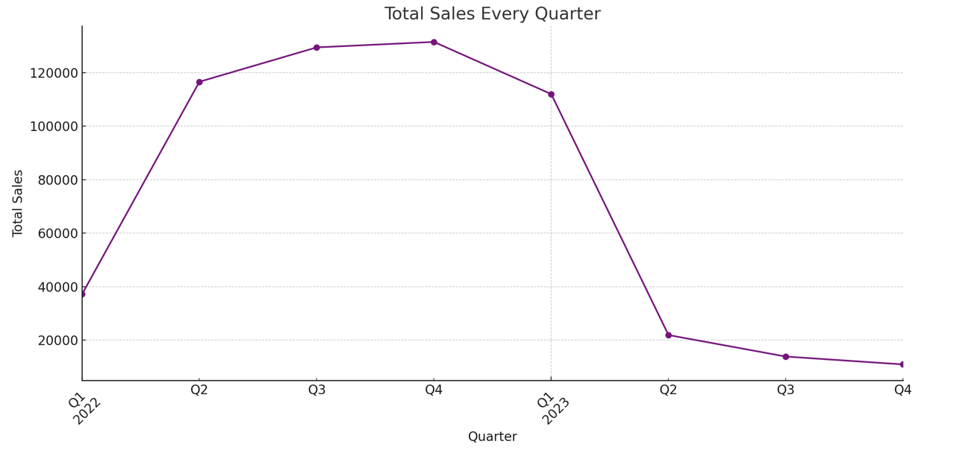

Slide 13
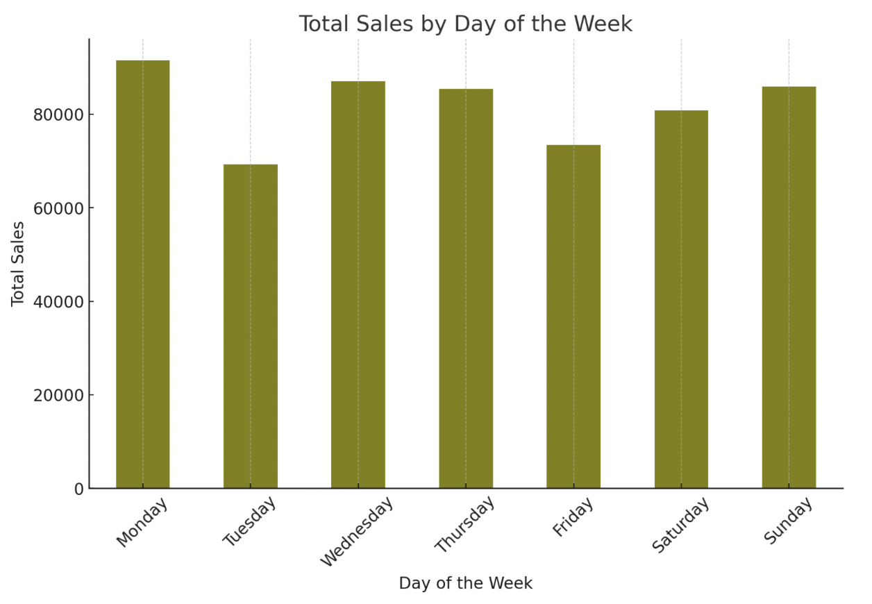

Slide 14
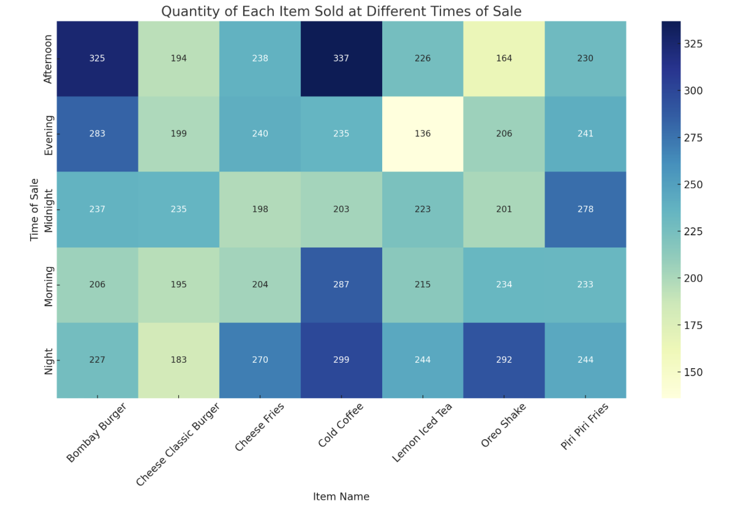

Slide 15
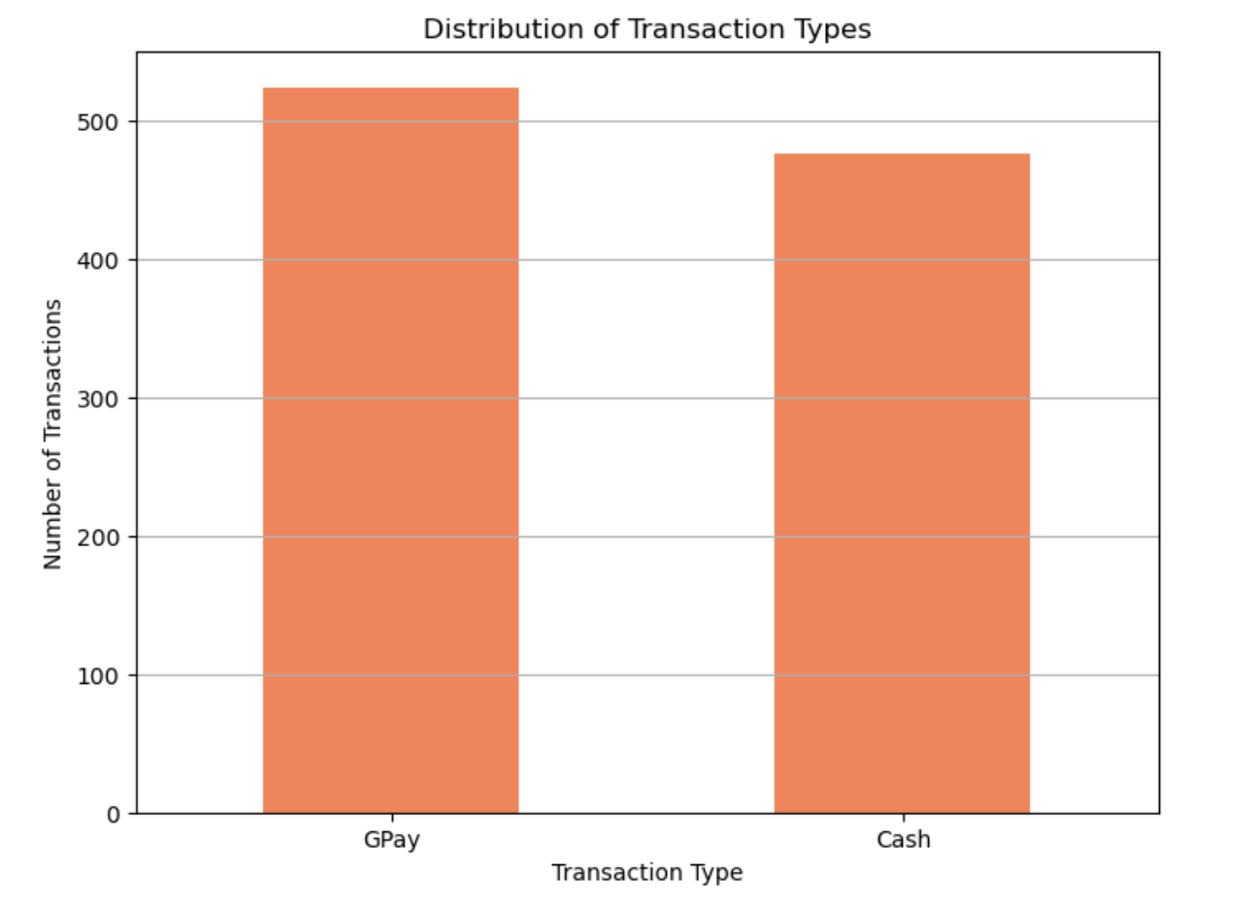

Slide 16
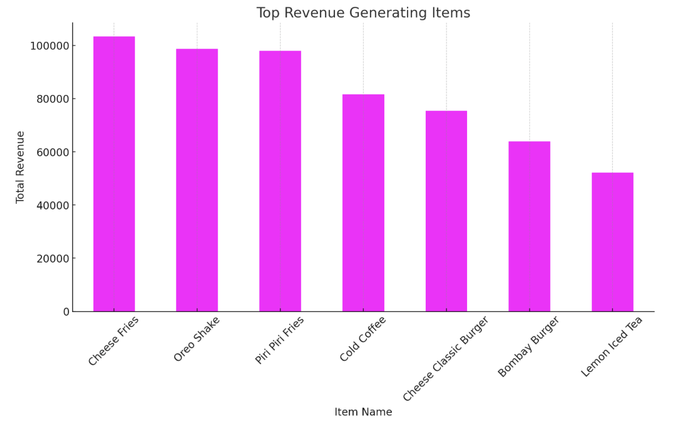

Slide 17
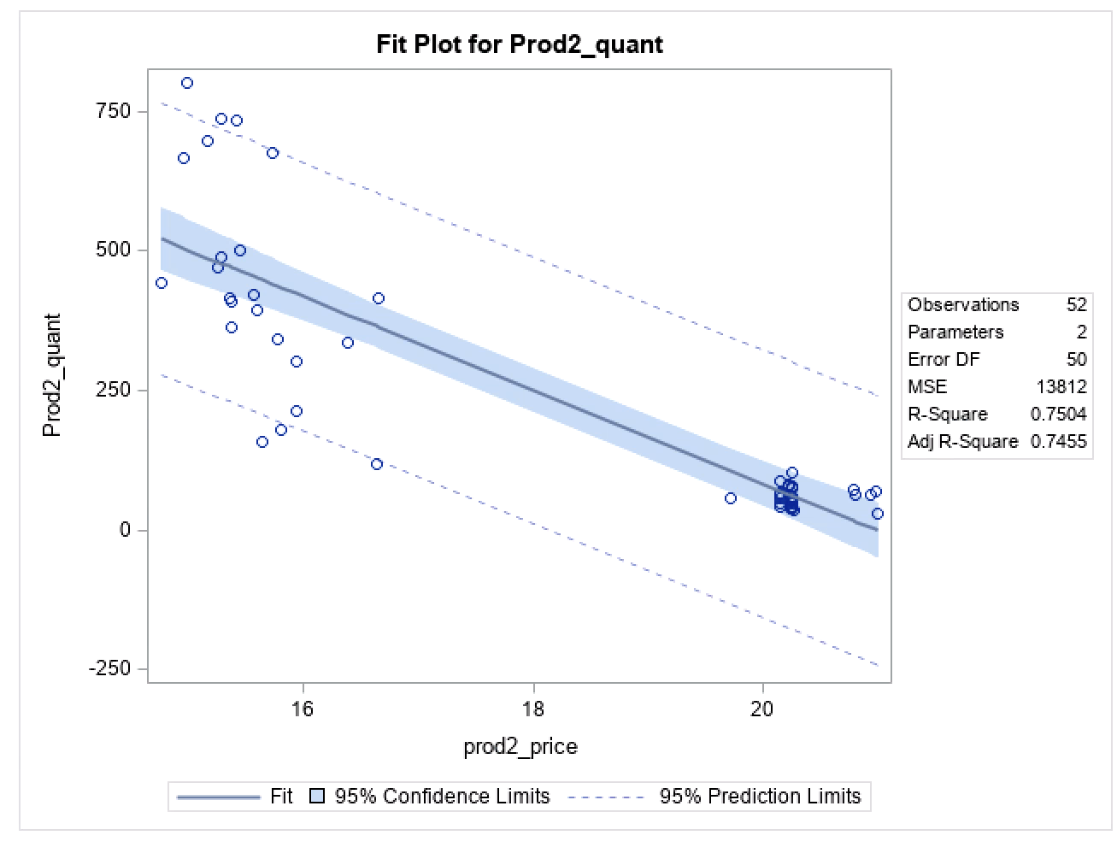
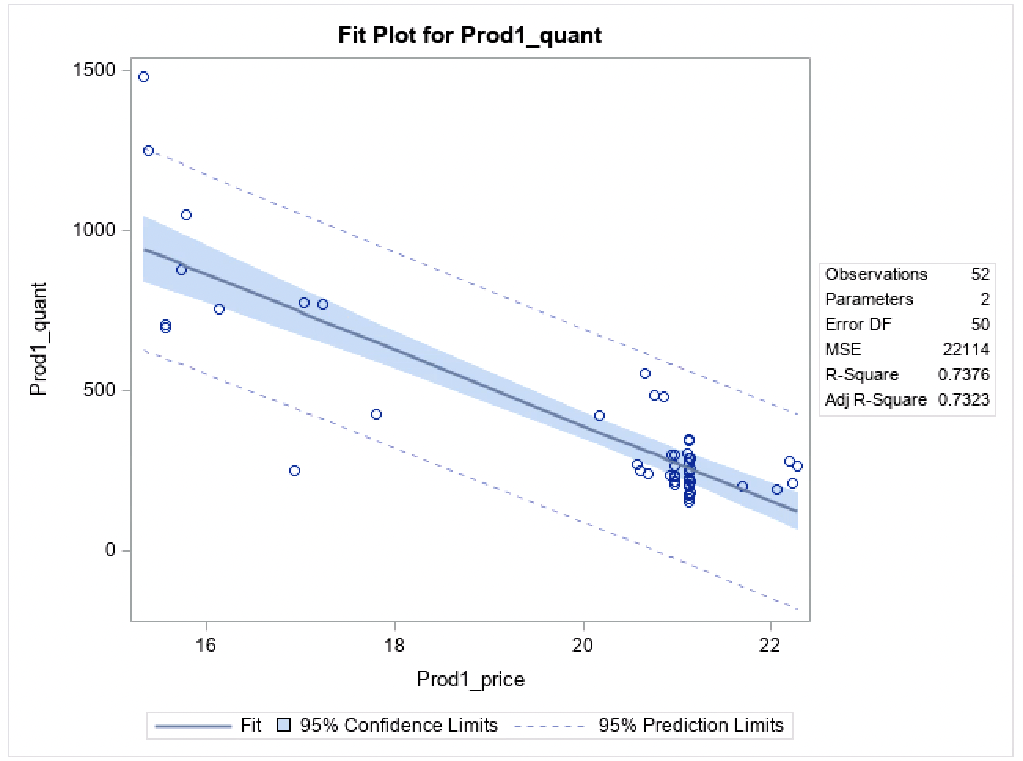
Price Elasticity Fits

Slide 18
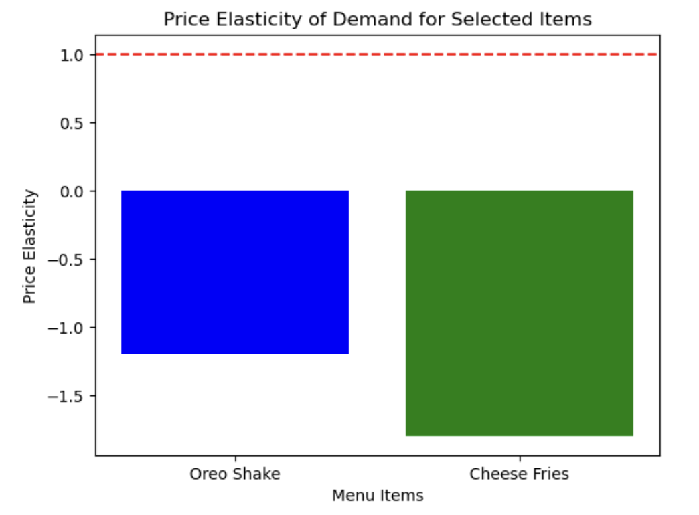

Slide 19
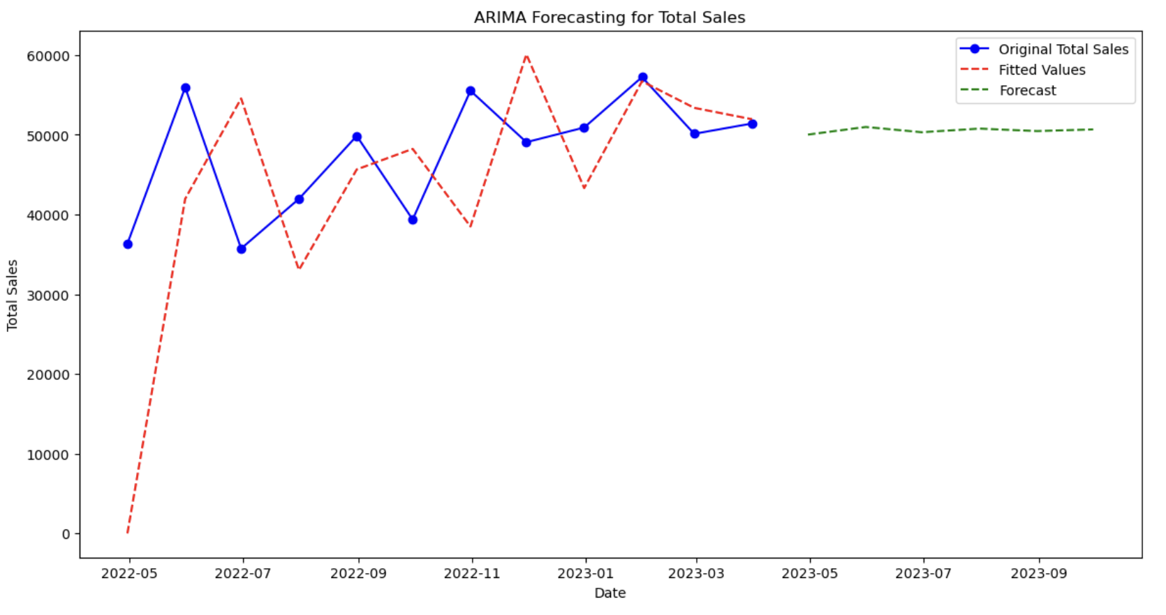

Slide 20
Marketing Plan
1. Focus on High-Revenue Items
Strategy: Prioritize marketing and promotions for items like Cheese Fries, Oreo Shake, and Piri Piri Fries, which are your top revenue generators.
Action: Create combo deals including high and low revenue items and offer small discounts on bulk purchases of these items to encourage larger orders.
2. Target Specific Times of Day
Strategy: Develop special promotions or menu items for times of day with lower sales to boost revenue during these periods.
Action: If mornings are slower, introduce a breakfast special or morning happy hour. For late nights, consider special deals or a late-night menu.
3. Leverage Popular Days
Strategy: Capitalize on days with higher sales volumes (as identified in the sales data).
Action: Host events or special promotions on these days. Consider loyalty rewards for customers visiting on less busy days to balance out the weekly sales.
4. Enhance Online Presence
Strategy: Strengthen your online ordering system and delivery options, especially if a significant portion of your transactions is online.
Action: Invest in social media advertising, optimize your website for online orders, and possibly partner with food delivery platforms.

Slide 21
Marketing Plan
5. Seasonal and Time-Based Campaigns
Strategy: Create marketing campaigns targeting specific seasons or holidays.
Action: Offer seasonal menu items, holiday discounts, or themed events. Utilize email marketing to inform customers about these special offers.
6. Customer Engagement and Feedback
Strategy: Engage with customers to gather feedback and build a community.
Action: Implement a customer feedback system, create a loyalty program, and actively engage with customers on social media.
7. Menu Optimization
Strategy: Regularly review and update the menu based on sales data and customer preferences.
Action: Consider removing low-selling items, introducing new dishes inspired by best-sellers, and adjusting prices based on cost and popularity.

Slide 22
Contingency Plan
1. Diversification of Menu and Services
Risk: Dependence on a few high-revenue items or services.
Plan: Diversify the menu by introducing new items and expanding service offerings (e.g., catering, online cooking classes).
Action: Regularly review and update the menu; explore additional services that can be offered.
2. Supply Chain Disruptions
Risk: Interruptions in supply chain affecting inventory.
Plan: Develop relationships with multiple suppliers; maintain a buffer stock of essential items.
Action: Identify alternative suppliers; regularly review stock levels and adjust as needed.
3. Seasonal Fluctuations
Risk: Revenue drops during off-peak seasons.
Plan: Implement seasonal promotions; adjust staffing and operations during slower periods.
Action: Plan marketing campaigns for off-peak seasons; consider temporary staffing solutions.

Slide 23
Contingency Plan
4. Economic Downturns
Risk: Reduced customer spending during economic downturns.
Plan: Offer budget-friendly menu options; enhance value-for-money perception.
Action: Review and adjust pricing strategies; promote special deals and value meals.
5. Health and Safety Issues (e.g., Pandemic)
Risk: Impact on dine-in business due to health concerns.
Plan: Strengthen takeaway and delivery services; implement robust health and safety protocols.
Action: Enhance online ordering system; ensure compliance with health guidelines.
6. Customer Preference Changes
Risk: Menu becomes outdated or unappealing.
Plan: Stay updated on industry trends; regularly seek customer feedback.
Action: Conduct market research; implement menu changes based on feedback and trends.

Slide 24
Implementation Plan
1. Focus on High-Revenue Items
Timeline: Start immediately, ongoing.
Steps:
Analyze sales data to identify high and low-revenue items.
Create combo deals that pair popular and less popular items.
Design marketing materials for these combos (both online and in-store).
Train staff to upsell these combos.
2. Target Specific Times of Day
Timeline: Develop within 1 month, then ongoing.
Steps:
Identify slow periods from sales data.
Develop special menu items or discounts for these times.
Advertise these specials through social media, in-store signage, and local advertising.
Monitor sales response and adjust offerings as needed.
3. Leverage Popular Days
Timeline: Plan 1-2 months in advance, ongoing.
Steps:
Identify busiest days for special events or promotions.
Organize events or themed nights and promote them through various channels.
Consider loyalty rewards for visits on less busy days.
Evaluate the success of these events in driving additional traffic and sales.

Slide 25
Implementation Plan
4. Enhance Online Presence
Timeline: Start immediately, refine over 2-3 months.
Steps:
Improve website and online ordering system.
Increase social media activity and engage with customers.
Collaborate with online food delivery platforms.
Regularly update digital content and monitor online feedback.
5. Seasonal and Time-Based Campaigns
Timeline: Plan 2-3 months before each season or holiday.
Steps:
Identify key seasons/holidays and develop themed promotions.
Design and schedule email marketing campaigns.
Use social media to create excitement about seasonal offers.
Track the performance of these campaigns and adjust for future seasons.
6. Customer Engagement and Feedback
Timeline: Implement within 1 month, then ongoing.
Steps:
Set up a system for collecting customer feedback (online and in-store).
Actively respond to feedback and reviews.
Develop a loyalty program and promote it to customers.
Use customer feedback to make continuous improvements.

Slide 26
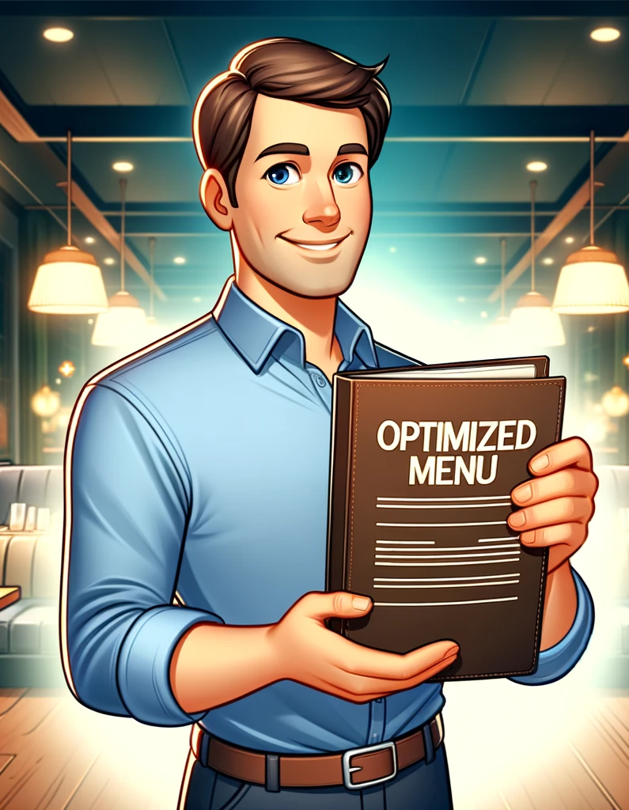
Implementation Plan
7. Menu Optimization
Timeline: Review quarterly, implement changes every 6 months.
Steps:
Regularly analyze sales data to identify menu trends.
Conduct customer surveys for direct feedback.
Decide on menu changes and test new items if possible.
Update the menu and train staff on new offerings.

Slide 27
Implementation Plan
Monitoring and Evaluation
Frequency: Monthly review of sales data and campaign performance.
Metrics: Sales figures, customer feedback, online engagement metrics, event attendance.
Adjustment: Be prepared to make swift changes based on what the data shows.
Staff Involvement and Training
Importance: Staff should be fully informed and trained on all new initiatives and promotions.
Approach: Regular staff meetings and training sessions to ensure everyone is aligned with the marketing efforts.

Slide 28
BUDGET
1. Focus on High-Revenue Items
Combo Deals & Bulk Discounts:
Costs: Additional inventory, marketing materials (e.g., flyers, digital ads).
Estimated Budget: ₹20,000 - ₹50,000 monthly
2. Target Specific Times of Day
Special Promotions (Breakfast, Late-Night):
Costs: Additional inventory, staff hours, advertising.
Estimated Budget: ₹30,000 - ₹60,000 monthly.
3. Leverage Popular Days
Events & Special Promotions:
Costs: Event materials, additional staff, marketing.
Estimated Budget: ₹15,000 - ₹45,000 per event.
4. Enhance Online Presence
Digital Marketing & Platform Partnerships:
Costs: Digital marketing services, platform commission fees.
Estimated Budget: ₹25,000 - ₹75,000 monthly.

Slide 29
BUDGET
5. Seasonal and Time-Based Campaigns
Seasonal Promotions & Email Marketing:
Costs: Marketing campaign creation, email service provider.
Estimated Budget: ₹15,000 - ₹45,000 per campaign
6. Customer Engagement and Feedback
Feedback System & Social Media Engagement:
Costs: Customer feedback tools, social media management.
Estimated Budget:₹10,000 - ₹30,000 monthly.
7. Menu Optimization
Menu Update & Price Adjustments:
Costs: Research, printing new menus, marketing new items.
Estimated Budget: ₹15,000 - ₹30,000 for each menu update.

Slide 30
BUDGET
Total Estimated Monthly Budget:
Minimum: ₹1,30,000
Maximum: ₹3,35,000
Additional Considerations:
Staff Training: For new menu items or services.
Contingency Funds: Allocate around 10-15% of the total budget for unforeseen expenses.
Monitoring & Evaluation: Budget for tools or services to track the effectiveness of these strategies.

Slide 31

Thank You!

